Slide 1
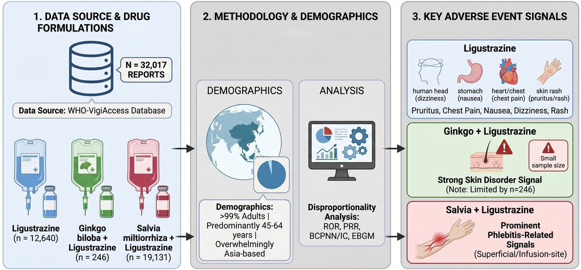

Adverse events related to ligustrazine-containing drugs for cardiovascular and cerebrovascular diseases
DOI: 10.5114/aoms/226092
Notes:
Introduction
To characterize adverse-event (AE) reporting patterns and disproportionality signals for three ligustrazine-containing injectable formulations used for cardiovascular and cerebrovascular diseases: ligustrazine, Ginkgo biloba with ligustrazine, and Salvia miltiorrhiza with ligustrazine.
Material and methods
Publicly available WHO-VigiAccess data were searched on November 24, 2024. Reports were summarized by formulation, sex, age group, continent, year, MedDRA System Organ Class (SOC), and Preferred Term (PT). Disproportionality was assessed using the Reporting Odds Ratio (ROR), Proportional Reporting Ratio (PRR), Bayesian Confidence Propagation Neural Network/Information Component (BCPNN/IC), and Empirical Bayes Geometric Mean (EBGM). For each formulation, the comparator consisted of all other medicinal-product reports available through the VigiAccess/VigiBase aggregate counts. Because spontaneous-report data lack exposure denominators, results are interpreted as reporting signals rather than incidence, absolute risk, comparative clinical safety, or causal evidence.
Results
A total of 32,017 reports were retrieved: 12,640 for ligustrazine, 246 for Ginkgo biloba with ligustrazine, and 19,131 for Salvia miltiorrhiza with ligustrazine. Reports were overwhelmingly Asia-based. The 45–64-year age group accounted for the largest reporting proportion across formulations, and adult reports represented more than 99% of reports in each group. General disorders/administration-site conditions, skin and subcutaneous tissue disorders, gastrointestinal disorders, nervous system disorders, and vascular disorders were frequent SOC categories. Ginkgo biloba with ligustrazine showed a relatively stronger skin-disorder signal at the SOC level (ROR = 3.36; PRR = 2.78; IC = 1.48; EBGM = 2.78), but interpretation is limited by the small report volume. Salvia miltiorrhiza with ligustrazine showed prominent phlebitis-related PT signals, including superficial phlebitis (EBGM = 191.09), phlebitis (EBGM = 155.82), and infusion-site phlebitis (EBGM = 125.62). Ligustrazine reports frequently included pruritus, chest pain, nausea, dizziness, and rash. Age and sex patterns were interpreted only as reporting distributions, not as incidence peaks or susceptibility signals.
Conclusions
The three ligustrazine-containing injectable formulations showed different AE reporting patterns in VigiAccess. These findings should be considered hypothesis-generating pharmacovigilance signals and require validation in denominator-based, clinically annotated, and preferably prospective data sources. Clinical interpretation should account for geography, product utilization, indication, infusion practice, reporting bias, duplicate reporting, and the highly unbalanced number of reports across formulations.

