Slide 1
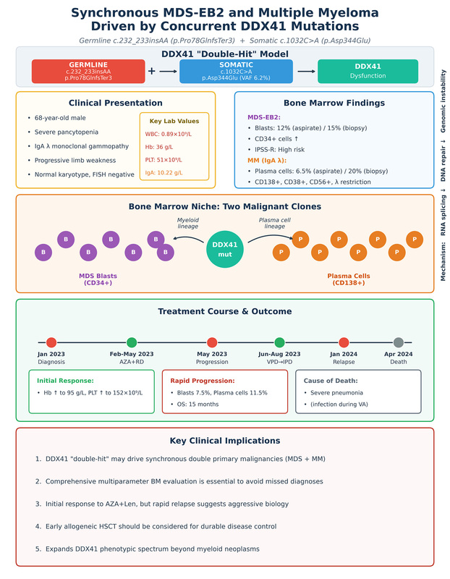

Synchronous myelodysplastic syndrome and multiple myeloma: a DDX41-associated double-hit across two lineages
DOI: 10.5114/aoms/226402
Arch Med Sci 2026;22(4):2490-2495
Notes:
Introduction
Material and methods
Results
Conclusions

