Slide 1
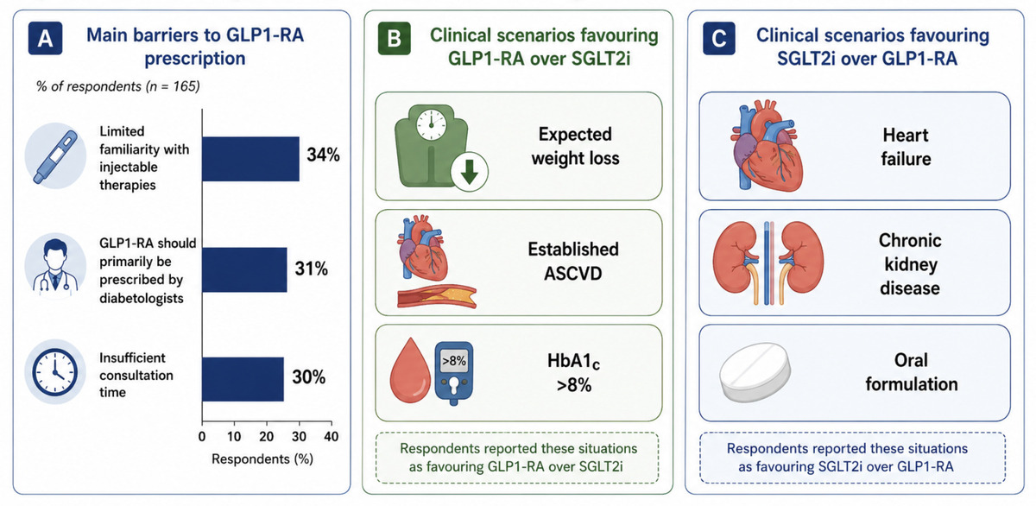

GLP-1 receptor agonists and SGLT2 inhibitors in cardiovascular practice: insights from a national survey of French cardiologists
DOI: 10.5114/aoms/226415
Arch Med Sci 2026;22(4):2465-2468
Notes:
Introduction
Not applicable.
Material and methods
Not applicable.
Results
Not applicable.
Conclusions
Not applicable.

