Slide 1
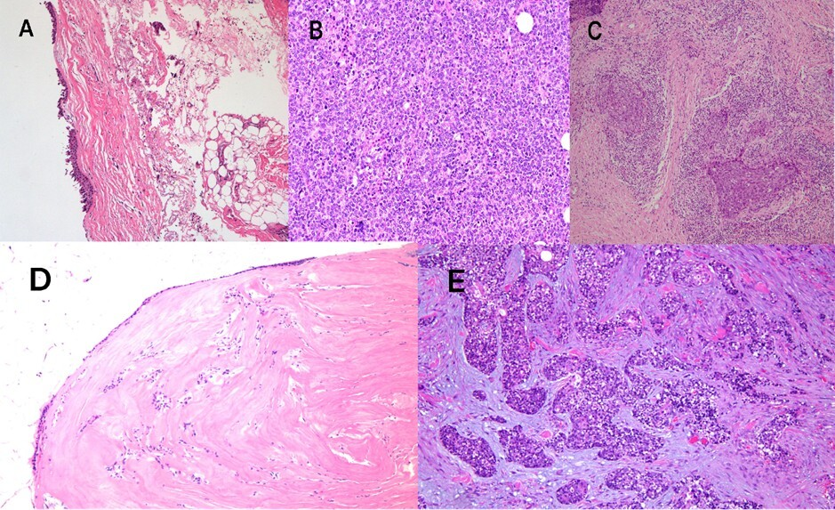

Orbital-sinonasal interface tumors (OSITs): a preliminary anatomical classification system and surgical approach
DOI: 10.5114/aoms/226688
Arch Med Sci 2026;22(4):2500-2506
Notes:
Introduction
Material and methods
Results
Conclusions

