Slide 1
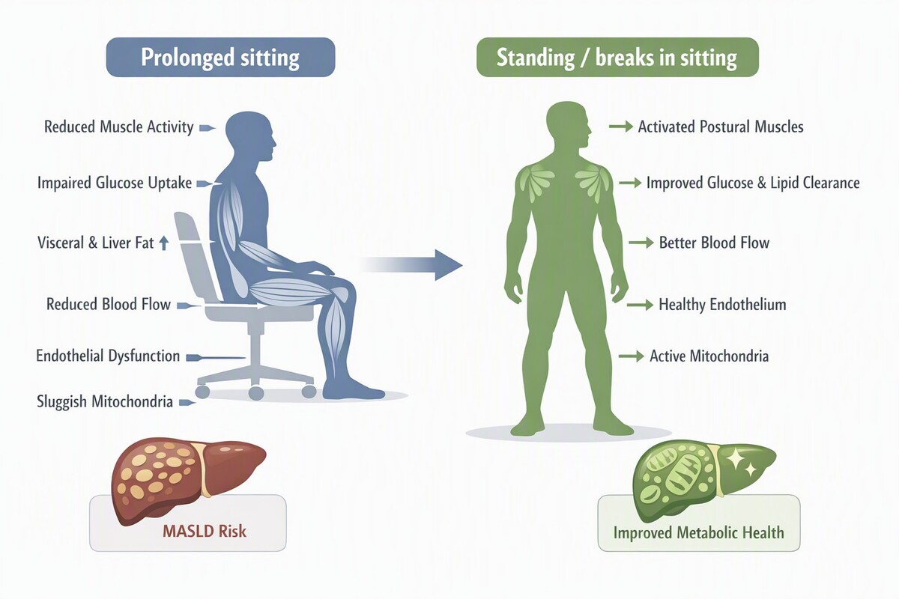

Editorial: Stand up to stay healthy?
DOI: 10.5114/aoms/226709
Arch Med Sci 2026;22(4):2095-2097

