Slide 1
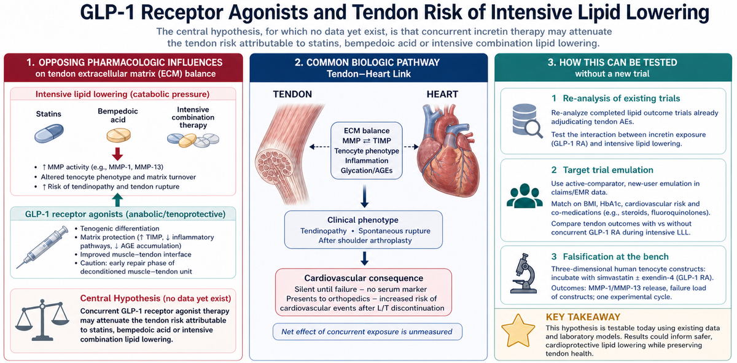

Beyond muscle: could GLP-1 receptor agonists offset the tendon risk of intensive lipid-lowering therapy?
DOI: 10.5114/aoms/226714
Arch Med Sci 2026;22(4):2002-2005

