Slide 1
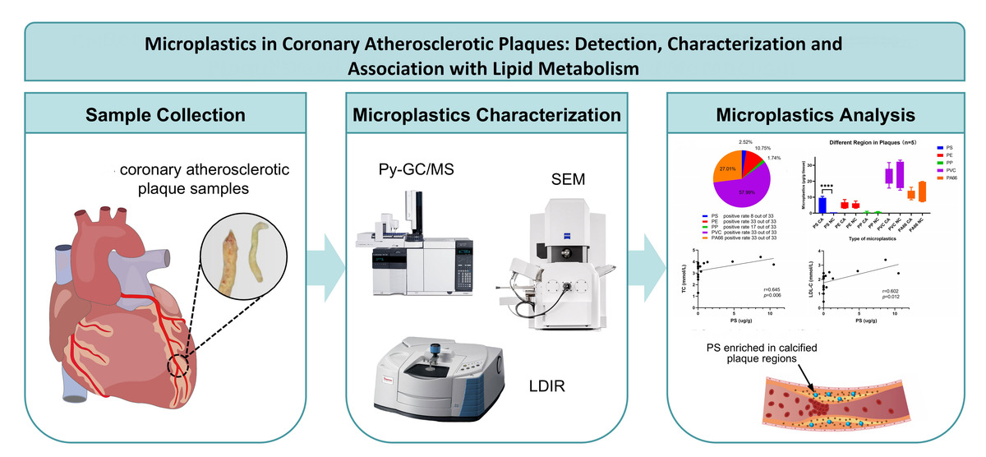

Preliminary detection and characterization of microplastics in human coronary atherosclerotic plaques
DOI: 10.5114/aoms/230932
Arch Med Sci 2026;22(4):2461-2464
Notes:
Introduction
Material and methods
Results
Conclusions

