Slide 1
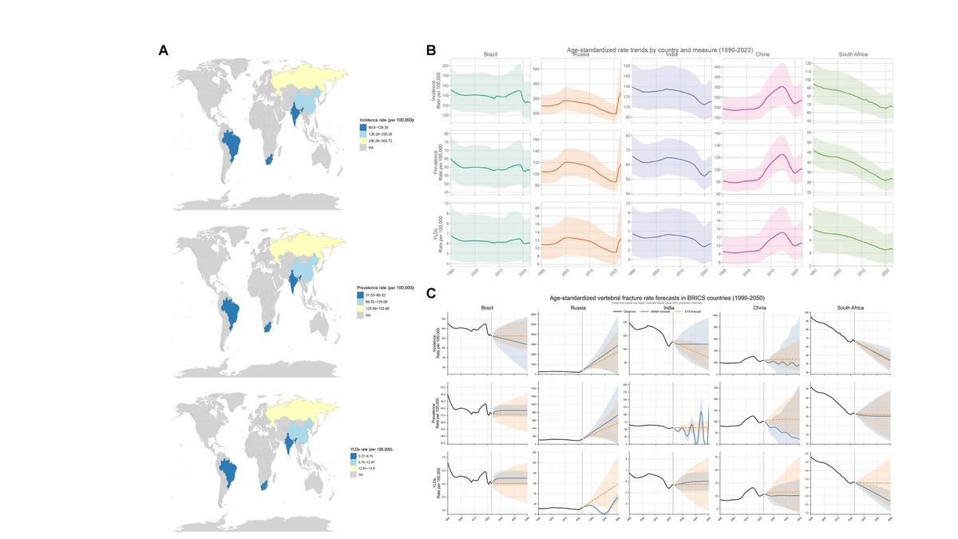

Epidemiological trends and future projections of vertebral fracture in BRICS countries: a GBD 2023 study
DOI: 10.5114/aoms/231346
Arch Med Sci 2026;22(4):2496-2499
Notes:
Introduction
Material and methods
Results
Conclusions

