Slide 1
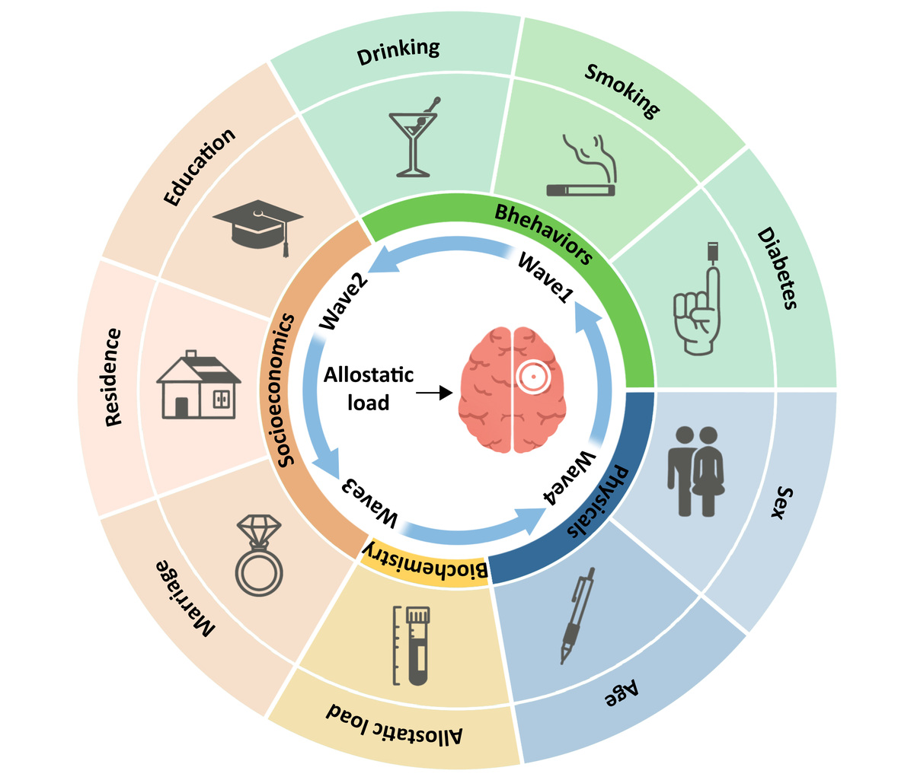

Allostatic load and incident stroke risk in middle-aged and older Chinese adults: a prospective cohort study from CHARLS
DOI: 10.5114/aoms/231562
Arch Med Sci 2026;22(4):2486-2489
Notes:
Introduction
Material and methods
Results
Conclusions

