Slide 1
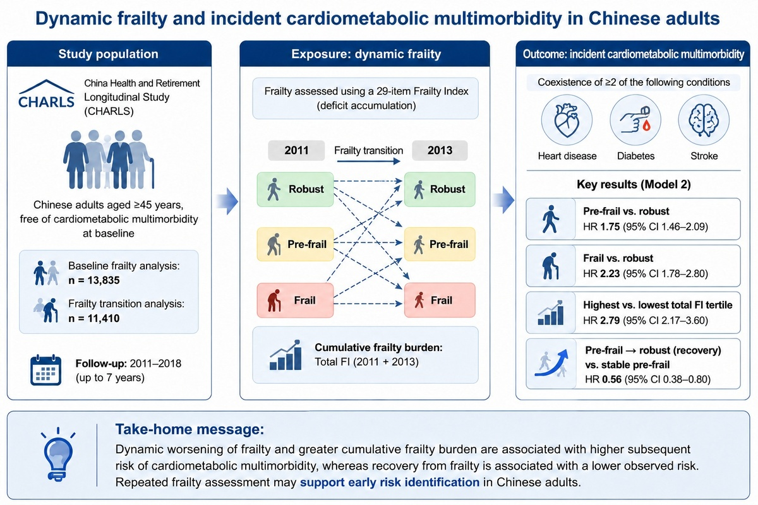

Dynamic frailty and incident cardiometabolic multimorbidity in Chinese adults
DOI: 10.5114/aoms/231563
Arch Med Sci 2026;22(4):2475-2478
Notes:
Introduction
Material and methods
Results
Conclusions

