Slide 1
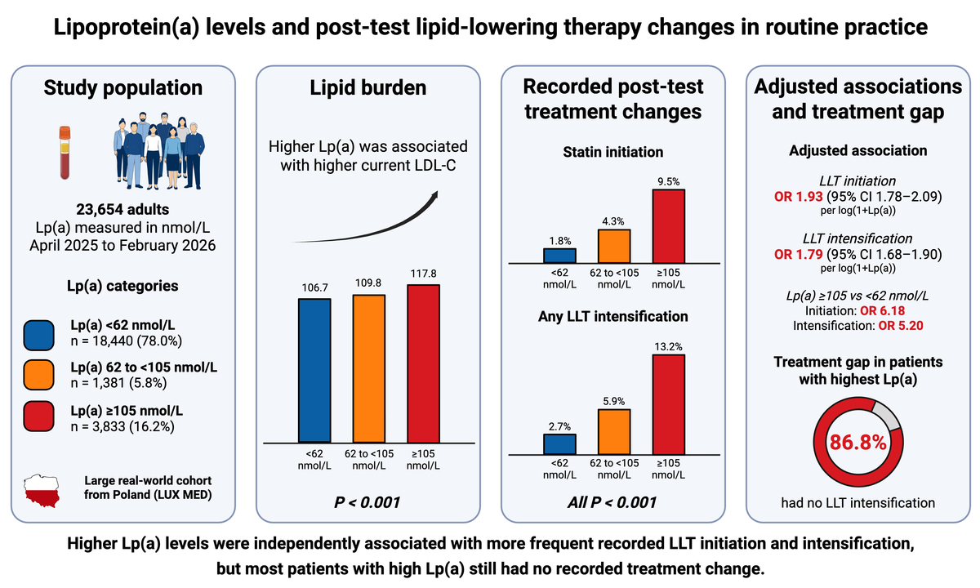

Lipoprotein(a) levels and recorded post-test changes in lipid-lowering therapy in a large real-world Polish cohort
DOI: 10.5114/aoms/231693
Notes:
Introduction
Elevated lipoprotein(a) [Lp(a)] is a recognized cardiovascular risk factor, but its association with subsequent lipid-lowering treatment (LLT) patterns is unclear. We assessed whether higher Lp(a) levels were associated with recorded post-test changes in lipid-lowering therapy (LLT).
Material and methods
This retrospective observational study included 23,654 adults tested for Lp(a) within LUX MED, a nationwide private healthcare network in Poland (April 2025-February 2026). Patients were categorized as Lp(a) <62, 62 to <105, or ≥105 nmol/L. Recorded statin initiation, escalation, ezetimibe initiation, and any LLT intensification recorded after Lp(a) testing were compared across categories. Multivariable logistic regression evaluated associations between Lp(a) and LLT initiation and intensification, adjusting for age, sex, body mass index, atherosclerotic cardiovascular disease (ASCVD), current LDL-C, HDL-C, and triglycerides; intensification models additionally adjusted for baseline statin and ezetimibe use.
Results
Current LDL-C increased across categories (P<0.001). Statin initiation was 1.8%, 4.3%, and 9.5%, while any LLT intensification was 2.7%, 5.9%, and 13.2% across increasing Lp(a) categories (both P<0.001). Higher Lp(a) remained associated with LLT initiation (OR 1.93, 95% CI 1.78–2.09) and intensification (OR 1.79, 95% CI 1.68–1.90; both P <0.001) per 1-unit increase in ln[1+Lp(a)]. Associations were stronger in younger patients and, for intensification, in women and patients without ASCVD. However, 86.8% of patients with Lp(a) ≥105 nmol/L had no recorded intensification.
Conclusions
Higher Lp(a) was associated with more frequent recorded post-test LLT initiation and intensification, but absolute rates remained low. These findings suggest an implementation gap but cannot establish that Lp(a) testing itself prompted treatment change.

