Slide 1
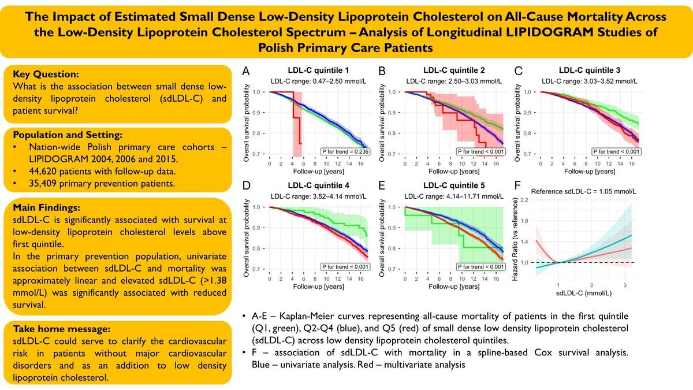

The Impact of Estimated Small Dense Low-Density Lipoprotein Cholesterol on All-Cause Mortality Across the Low-Density Lipoprotein Cholesterol Spectrum – Analysis of Longitudinal LIPIDOGRAM Studies of Polish Primary Care Patients
DOI: 10.5114/aoms/235713
Notes:
Introduction
The small dense low-density lipoprotein cholesterol (sdLDL-C) fraction has been shown to be significantly more atherogenic than large buoyant low-density lipoprotein cholesterol, but its estimation or measurement has not found widespread clinical use. In this study, we aimed to assess the association of sdLDL-C with mortality of Polish primary care patients.
Material and methods
This study analyzed 45,585 patients from Polish nationwide LIPIDOGRAM 2004, 2006, and 2015 cross-sectional studies of primary care patients. Median follow-up was 15.3 years. sdLDL-C was estimated using the method published by Sampson et al. Mortality was analyzed in the primary prevention group without major cardiovascular diseases and across low-density lipoprotein cholesterol (LDL-C) quintiles.
Results
Median estimated sdLDL-C was 1.04 mmol/L (IQR 0.82; 1.31). Multivariable analysis of LIPIDOGRAM2015 subgroup revealed significant negative correlations with statin use, previous myocardial infarction, and high-density lipoprotein cholesterol. sdLDL-C was significantly associated with mortality across all LDL-C quintiles except the first quintile (p<0.001). In the population without major cardiovascular diseases (CVD) of 35,409 patients, elevated sdLDL-C (above the 80th percentile; >1.38 mmol/L) displayed a significant relationship with increased mortality (p<0.001). In the univariable, spline-based analysis of this subgroup, the relationship between sdLDL-C and mortality was approximately linear, although the multivariable analysis showed a U-shaped curve with the lowest mortality at 1.05 mmol/L.
Conclusions
sdLDL-C appears to be significantly associated with longterm mortality beyond elevated LDL-C and in patients without major CVD. Further research is needed to establish causal relationship with CVD and treatment targets.

