Slide 1
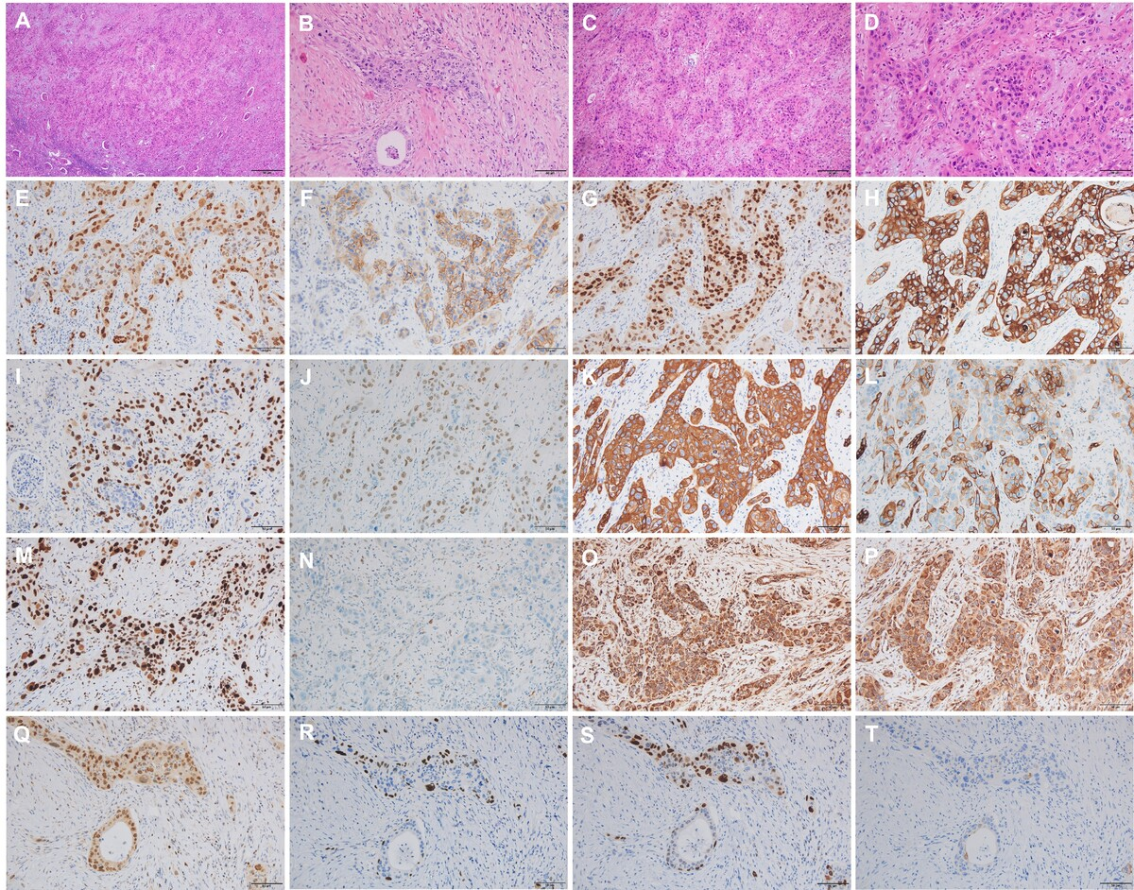

Primary renal parenchymal squamous cell carcinoma: a case report and literature review
DOI: 10.5114/aoms/235877
Arch Med Sci 2026;22(4):2522-2533

