Slide 1
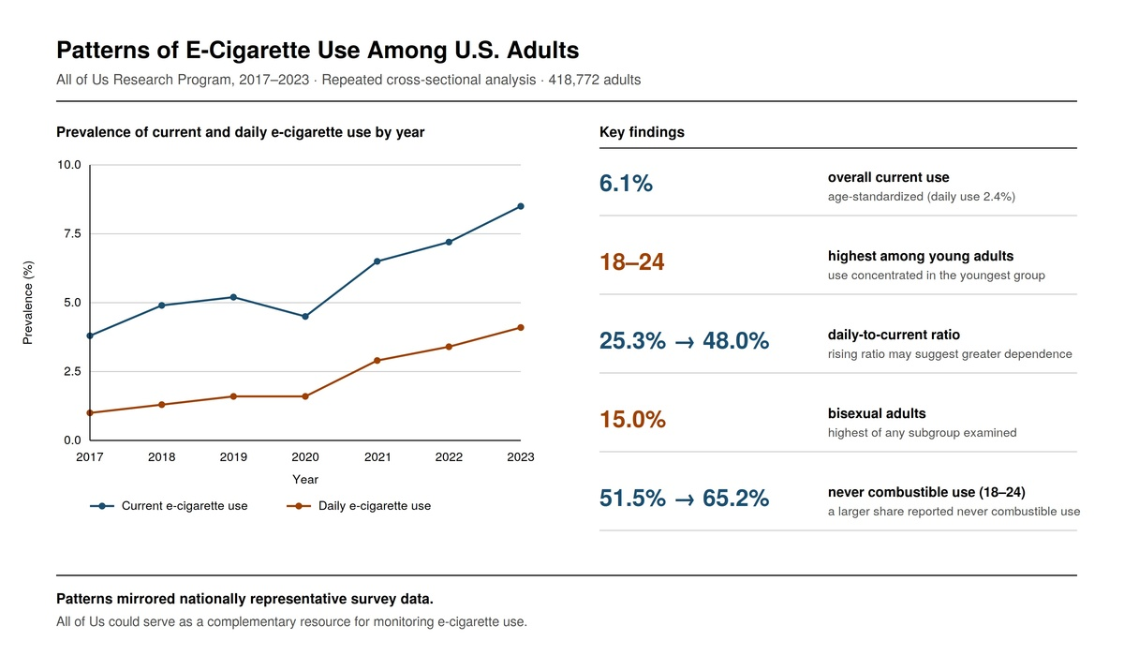

Prevalence and Patterns of E-Cigarette Use Among U.S. Adults: A Repeated Cross-Sectional Analysis of the All of Us Research Program, 2017–2023
DOI: 10.5114/aoms/235979
Notes:
Introduction
Large-scale, ongoing cohort studies may offer a complementary approach for monitoring population patterns of e-cigarette use alongside established national surveillance systems. This study assessed the prevalence and patterns of current and daily e-cigarette use among adults in the All of Us Research Program from 2017 to 2023 and compared observed patterns with those from established national surveys.
Material and methods
This repeated cross-sectional analysis included adults aged 18 years or older who completed the All of Us Lifestyle Survey between 2017 and 2023. Current and daily e-cigarette use were ascertained through self-reported survey items. The analytic cohort was sex-balanced through random subsampling of female participants (1:1 ratio), and overall prevalence estimates were age-standardized to the 2020 U.S. Census adult age distribution. All analyses were descriptive.
Results
The analytic sample included 418,772 participants. Age-standardized prevalence of current e-cigarette use was 6.1% (95% CI: 6.0–6.2), and daily use was 2.4% (95% CI: 2.3–2.4). Prevalence was highest among adults aged 18–24 years (13.3%), male participants (7.0%), and those with depression (7.5%). Annual current use prevalence rose from 3.8% in 2017 to 8.5% in 2023, with a dip to 4.5% in 2020. Among young adults reporting current e-cigarette use, the proportion reporting never combustible cigarette use grew from 51.5% in 2017 to 65.2% in 2023.
Conclusions
E-cigarette use was most common among young adults, with patterns consistent with nationally representative datasets. These findings support the potential of the All of Us Research Program as a complementary resource for monitoring e-cigarette use.

