Slide 1
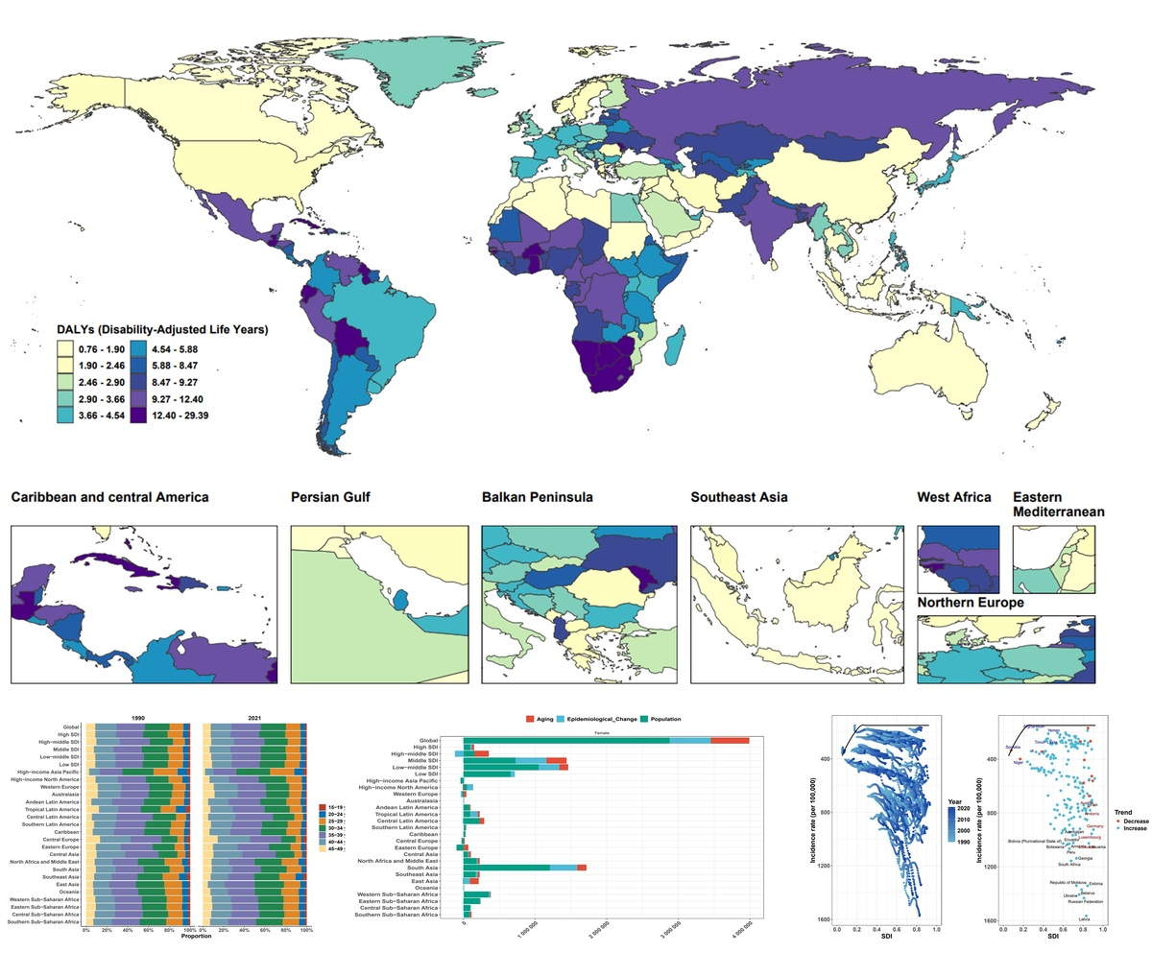

Global burden of uterine fibroids among reproductive-aged women
DOI: 10.5114/aoms/236908
Notes:
Introduction
Material and methods
Results
Conclusions

