Slide 1
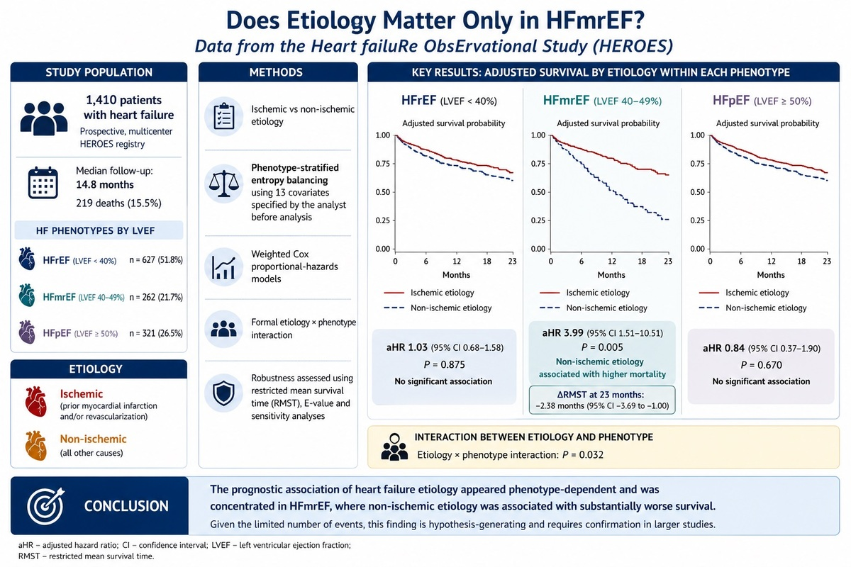

Does etiology matter only in HFmrEF? Data from the HEart failuRe ObsErvational Study (HEROES)
DOI: 10.5114/aoms/236909
Notes:
Introduction
Heart failure (HF) with mildly reduced ejection fraction (HFmrEF) is a heterogeneous phenotype, and whether the prognostic weight of ischemic versus non-ischemic etiology differs across left ventricular ejection fraction (LVEF) categories remains uncertain. We examined whether the association between etiology and long-term all-cause mortality is modified by HF phenotype.
Material and methods
Within the prospective multicenter HEROES registry, 1,410 patients with HF were classified as having ischemic or non-ischemic etiology and categorized by LVEF. All-cause mortality was obtained through national administrative linkage with complete follow-up. Entropy balancing (13 covariates) and weighted Cox models were applied within each phenotype, with formal testing for etiology-by-phenotype interaction. Robustness was evaluated using restricted mean survival time (RMST), the E-value, and sensitivity analyses.
Results
Over a median follow-up of 14.8 months, 219 (15.5%) deaths occurred. Crude mortality was identical between etiologies (15.5% vs. 15.5%; p = 0.93). After balancing, no difference was observed in HFrEF (adjusted hazard ratio [aHR] 1.03, 95% CI: 0.68–1.58) or HFpEF (aHR = 0.84, 95% CI: 0.37–1.90), whereas non-ischemic etiology was associated with higher mortality in HFmrEF (aHR = 3.99, 95% CI: 1.51–10.51; p = 0.005). The etiology-by-phenotype interaction was significant (p = 0.032). In HFmrEF, the RMST difference at 23 months was −2.38 months (95% CI: −3.69 to −1.00), with an E-value of 4.55 (lower confidence limit 1.99); findings were consistent across sensitivity analyses.
Conclusions
The prognostic impact of HF etiology appears phenotype-dependent, concentrated within HFmrEF, where non-ischemic etiology substantially worse survival. Given the limited number of events, this phenotype-specific signal is hypothesis-generating and warrants confirmation.

