Slide 1
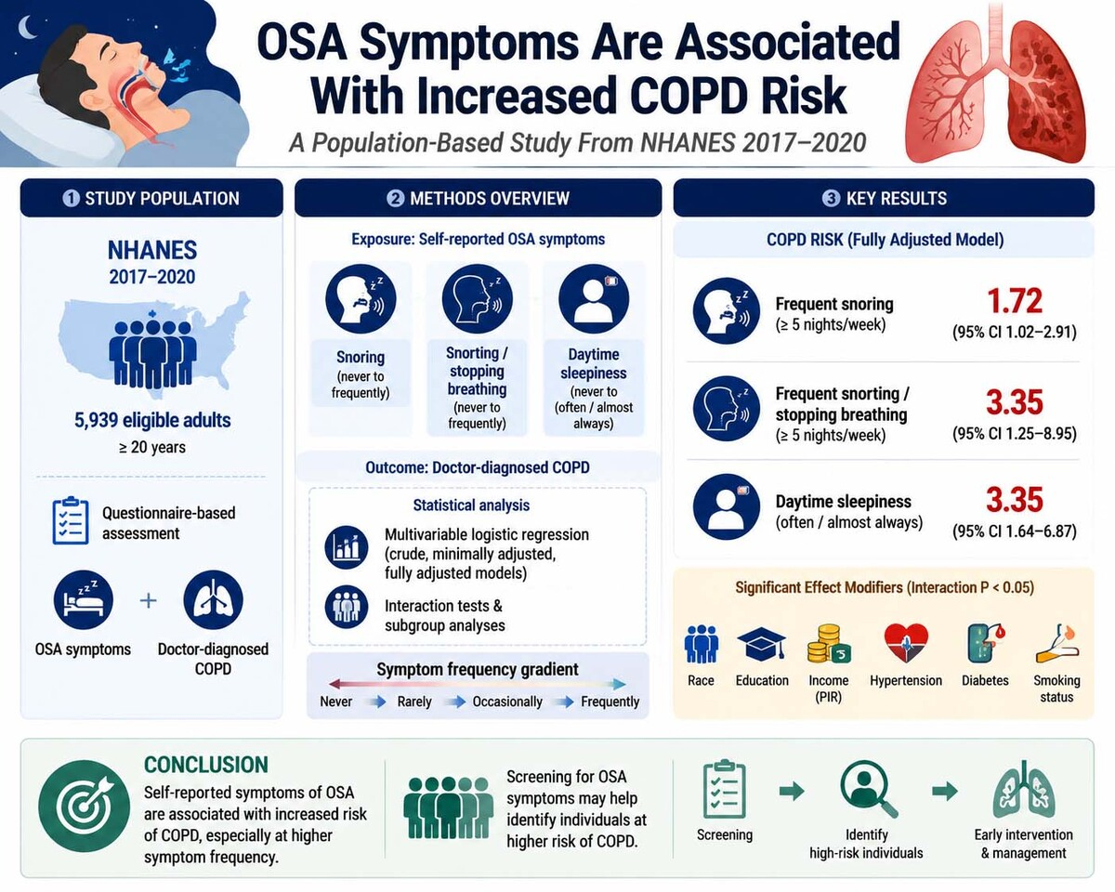

Association between self-reported symptoms of obstructive sleep apnea and chronic obstructive pulmonary disease: a population-based study
DOI: 10.5114/aoms/237550
Notes:
Introduction
Material and methods
Results
Conclusions

