Slide 1
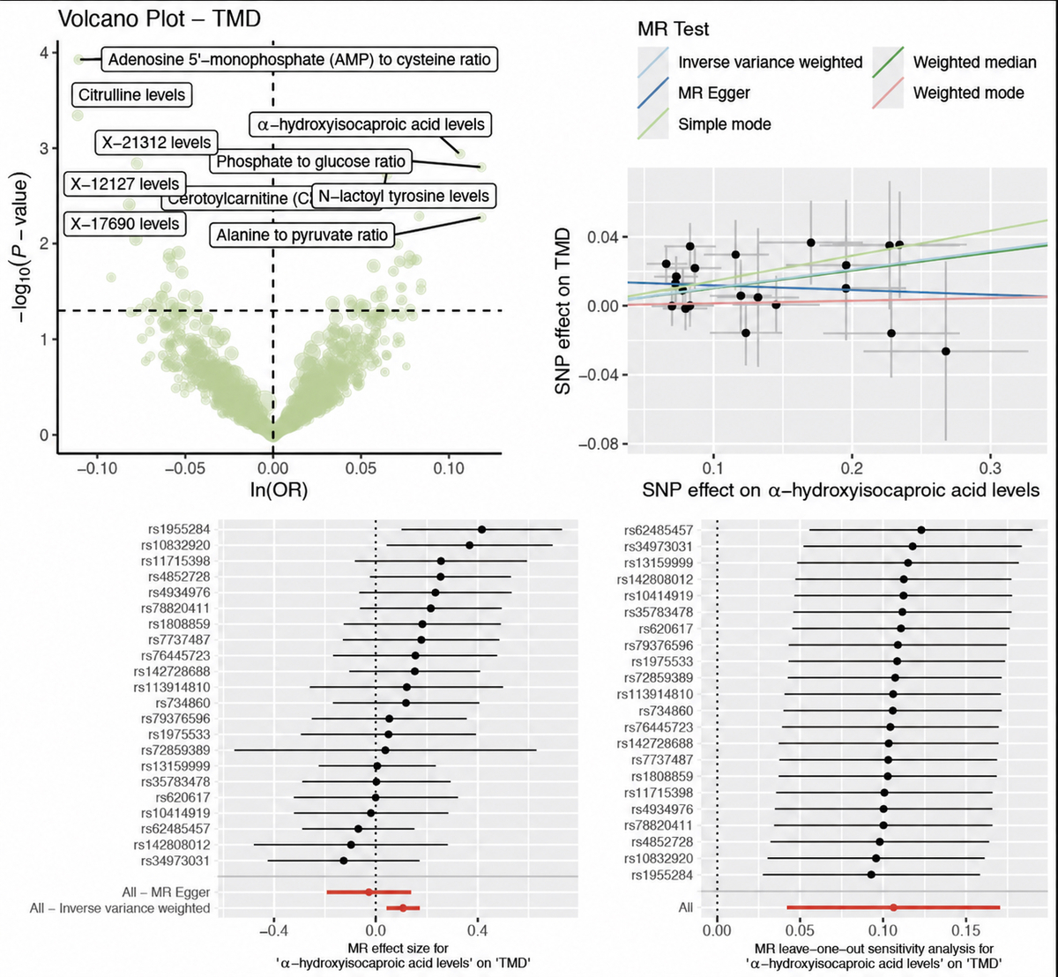

Effects of a home exercise program on symptoms and inflammatory markers in temporomandibular disorders
DOI: 10.5114/aoms/237551
Notes:
Introduction
Material and methods
Results
Conclusions

