Slide 1
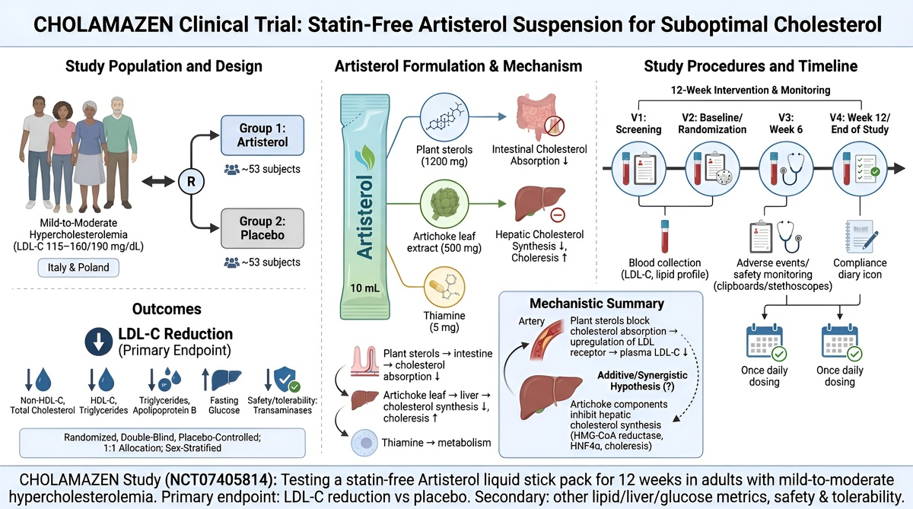

Design, Protocol, and Rationale of the Clinical Trial with a Novel Statin-Free Artisterol Gel Suspension in Subjects with Suboptimal Cholesterol Levels
DOI: 10.5114/aoms/240731
Notes:
Introduction
Elevated low-density lipoprotein cholesterol (LDL-C) is a causal, modifiable risk factor for atherosclerotic cardiovascular disease (ASCVD). In individuals at low-to-moderate cardiovascular risk who do not meet criteria for lipid-lowering pharmacotherapy, or who are not willing to use statins or are intolerant, non-pharmacological options are clinically relevant; however, efficacy must be demonstrated for the finished formulation rather than extrapolated from its individual ingredients.
Material and methods
CHOLAMAZEN (ClinicalTrials.gov NCT07405814) is an international, randomized, double-blind, placebo-controlled, parallel-group trial conducted in Italy and Poland. A total of 106 adults aged 18-70 years with previously untreated mild-to-moderate hypercholesterolemia will be randomized 1:1, stratified by sex, to receive Artisterol or matching placebo once daily for 12 weeks. Each 10-ml liquid stick pack of Artisterol provides 1,200 mg plant sterols, 500 mg artichoke (Cynara scolymus) leaf extract, and 5 mg thiamine (vitamin B1).
Results
The primary endpoint is the absolute mean change in LDL-C from baseline to Week 12. Secondary endpoints include changes in total cholesterol, HDL-C, non-HDL-C, triglycerides, apolipoprotein B, fasting plasma glucose and hepatic transaminases, together with adverse-event monitoring and compliance assessment. Exploratory analyses will evaluate LDL-C and secondary outcomes across baseline, Week 6 and Week 12.
Conclusions
This protocol is designed to determine whether a non-monacolin, statin-free liquid formulation containing plant sterols, artichoke leaf extract and thiamine lowers LDL-C versus placebo and is safe and well tolerated over 12 weeks. Reporting follows Standard Protocol Items: Recommendations for Interventional Trials (SPIRIT) 2025, and trial results will be reported according to the registered endpoints.

