Slide 1
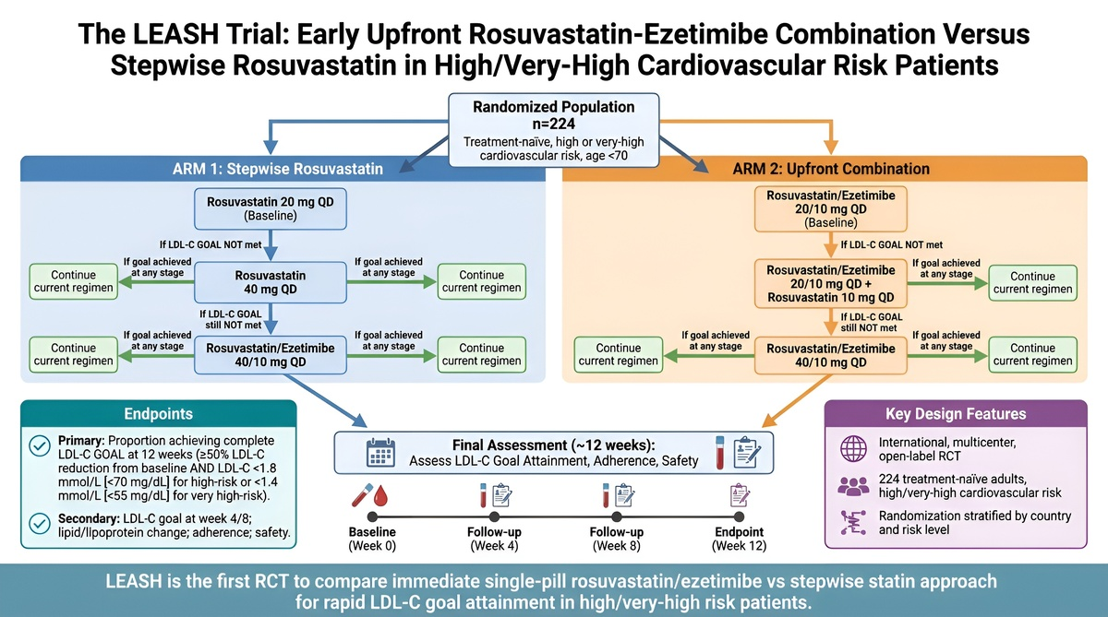

The LEASH trial: rationale and study design for early rosuvastatin-ezetimibe combination compared with stepwise rosuvastatin in high/very-high cardiovascular risk
DOI: 10.5114/aoms/240895
Notes:
Introduction
Contemporary guidelines recommend early achievement of stringent low-density lipoprotein cholesterol (LDL-C) goals in patients at high or very high cardiovascular risk. The LEASH trial evaluates upfront rosuvastatin/ezetimibe combination therapy with a conventional stepwise intensification strategy in treatment-naïve patients.
Material and methods
LEASH is an international, prospective, multicentre, randomised, open-label trial. Treatment-naïve adults aged < 70 years are randomised 1 : 1 within country and risk strata. Arm 1 starts with rosuvastatin 20 mg/day with protocol-directed stepwise escalation; Arm 2 starts with rosuvastatin/ezetimibe 20/10 mg/day (single-pill combination, SPC) with subsequent intensification. Treatment is reassessed at 4, 8, and 12 weeks. The primary endpoint is proportion of patients achieving complete LDL-C goal at week 12, defined as ≥ 50% reduction from baseline plus LDL-C < 1.8 mmol/l (< 70 mg/dl) for high-risk or < 1.4 mmol/l (< 55 mg/dl) for very-high-risk patients. Secondary endpoints include early goal attainment at week 4 and 8, lipoprotein changes, adherence, between-arm differences, and safety. A full analysis set of 224 patients is planned. The trial is registered as EU CT 2023-504914-31-00.
Results
The LEASH trial is the first randomised controlled trial (RCT) to evaluate the early (4–12 weeks) efficacy and safety of an upfront SPC (rosuvastatin/ezetimibe) for LDL C reduction and goal attainment in high and very high cardiovascular risk patients. The results will inform not just whether combination therapy is effective in this population, but – critically – whether earlier initiation shortens the time to LDL C goal attainment and, consequently, reduces the risk of first and subsequent cardiovascular events.
Conclusions
LEASH will assess whether upfront rosuvastatin/ezetimibe SPC therapy differs from conventional stepwise statin based lipid lowering intensification (with addition of ezetimibe as needed) in early (by 12 weeks) LDL C reduction and goal achievement. Therapy adherence and early safety differences between the two approaches will also be assessed.

