Slide 1
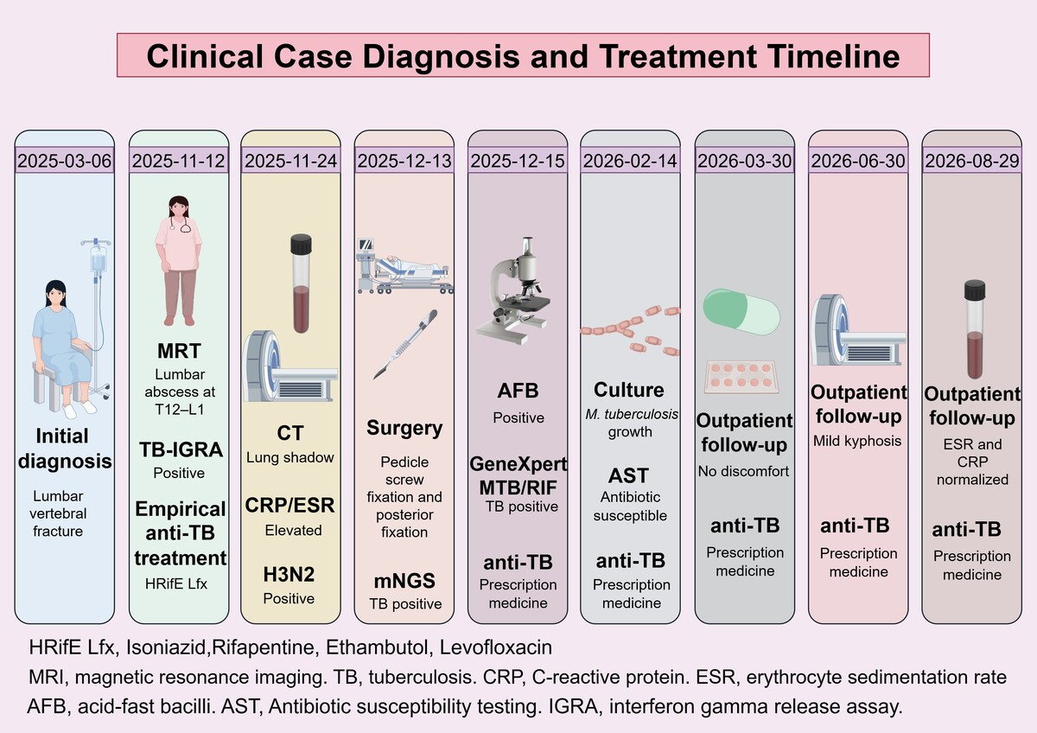

Spinal tuberculosis presenting as chronic low back pain and initially misdiagnosed as a lumbar sprain: a case report
DOI: 10.5114/aoms/241748

