Slide 1
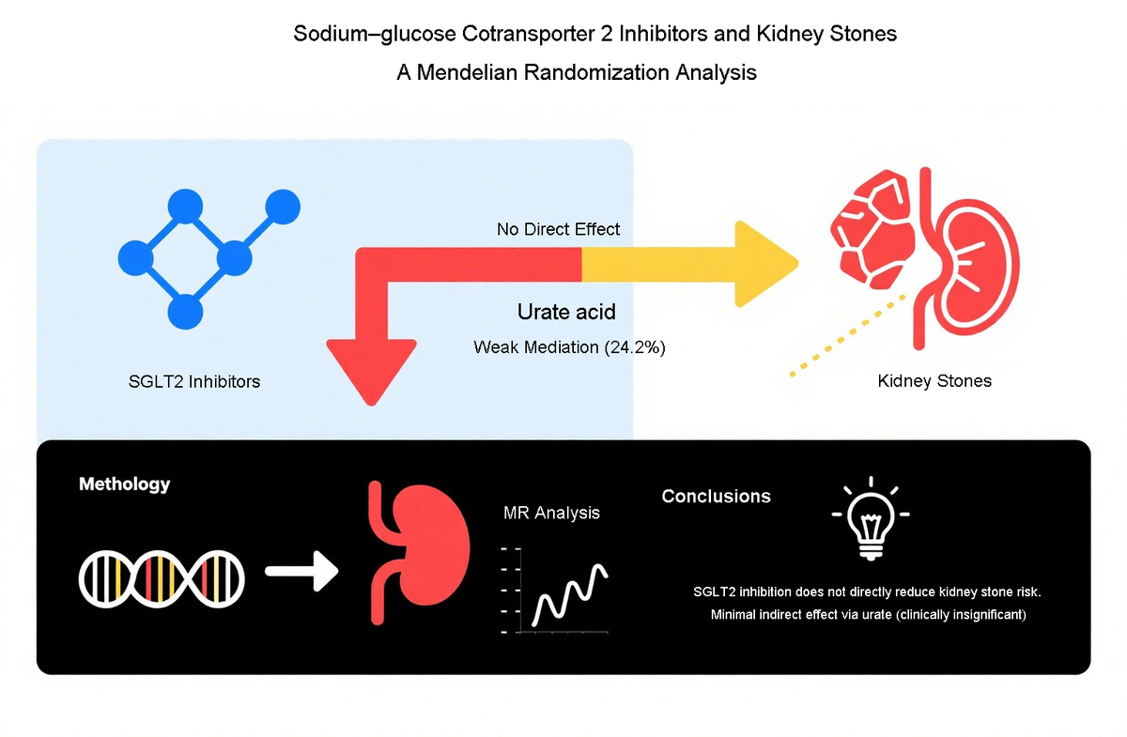

Sodium-glucose cotransporter 2 inhibitors and kidney stones: a Mendelian randomisation study
DOI: 10.5114/aoms/241749
Notes:
Introduction
NA
Material and methods
NA
Results
NA
Conclusions
NA

