Slide 1
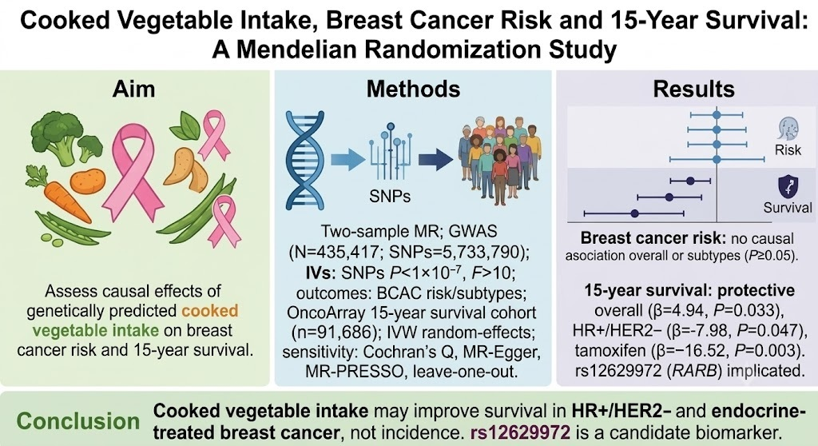

Causal effects of genetically predicted cooked vegetable intake on breast cancer risk and survival: a Mendelian randomisation study
DOI: 10.5114/aoms/242103
Notes:
Introduction
-
Material and methods
-
Results
-
Conclusions
-

