Slide 1
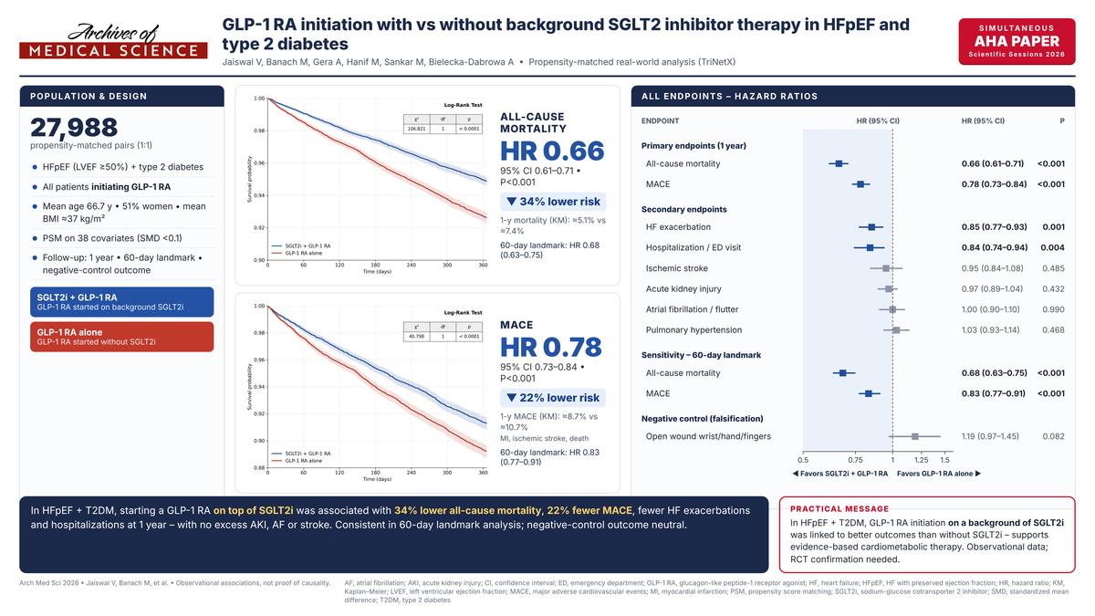

Clinical Outcomes Following GLP-1 Receptor Agonist Initiation With Versus Without Background SGLT2 Inhibitor Therapy in Heart Failure with Preserved Ejection Fraction and Type 2 Diabetes: A Propensity-Matched Real-World Analysis
Notes:
Introduction
SGLT2 inhibitors (SGLT2i) improve heart failure outcomes, and GLP-1 receptor agonists (GLP-1 RA) confer cardiometabolic benefit. However, outcomes after GLP-1 RA initiation according to background SGLT2i use remain uncertain.
Material and Methods
Using TriNetX, we compared GLP-1 RA initiation in patients with HFpEF and type 2 diabetes with versus without background SGLT2i. Cohorts were propensity-matched 1:1 and followed for one year, with 60-day landmark analyses.
Results
Among 27,988 matched pairs, background SGLT2i was associated with lower one-year all-cause mortality (HR 0.66, 95% CI 0.61–0.71) and major adverse cardiovascular events (MACE; HR 0.78, 95% CI 0.73–0.84; both P < 0.001). Landmark analyses were consistent for ACM (HR 0.68, 95% CI 0.63–0.75) and MACE (HR 0.83, 95% CI 0.77–0.91).
Conclusions
In HFpEF with type 2 diabetes, GLP-1 RA initiation on a background of SGLT2i therapy was associated with lower mortality and MACE than initiation without SGLT2i.

