Slide 1
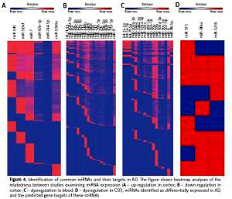

The role of the microRNA regulatory network in Alzheimer’s disease: a bioinformatics analysis
DOI: 10.5114/aoms/80619
Arch Med Sci 2022;18(1):206-222
Notes:
Introduction
Alzheimer’s disease (AD) is a neurodegenerative disease which presents with an earlier age of onset and increased symptom severity. The objective of this study was to evaluate the relationship between regulation of miRNAs and AD.
Material and methods
We completed a bioinformatic analysis of miRNA-AD studies through multiple databases such as TargetScan, Database for Annotation, Visualization and Integrated Discovery (DAVID), FunRich and String and assessed which miRNAs are commonly elevated or decreased in brain tissues, cerebrospinal fluid (CSF) and blood of AD patients. All identified articles were assessed using specific inclusion and exclusion criteria.
Results
MiRNAs related to AD of twenty-eight studies were assessed in this study. A wide range of miRNAs were up-regulated or down-regulated in tissues of AD patients’ brain, blood and CSF. Twenty-seven differentially dysregulated miRNAs involved in amyloidogenesis, inflammation, tau phosphorylation, apoptosis, synaptogenesis, neurotrophism, neuron degradation, and activation of cell cycle entry were identified. Additionally, our bioinformatics analysis identified the top ten functions of common miRNAs in candidate studies. The functions of common up-regulated miRNAs primarily target the nucleus and common down-regulated miRNAs primarily target transcription, DNA-templated.
Conclusions
Comprehensive analysis of all miRNA studies reveals cooperation in miRNA signatures whether in brain tissues or in CSF and peripheral blood. More and more studies suggest that miRNAs may play crucial roles as diagnostic biomarkers and/or as new therapeutic targets in AD. According to biomarkers, we can identify the preclinical phase early, which provides an important time window for therapeutic intervention.

