Slide 1
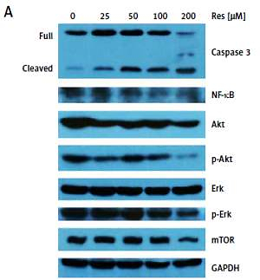

Resveratrol is cytotoxic and acts synergistically with NF-κB inhibition in osteosarcoma MG-63 cells
DOI: 10.5114/aoms.2020.100777
Arch Med Sci 2021;17(1):166-176
Notes:
Introduction
Osteosarcoma is the most common primary malignancy of the bone. The existing adjuvant chemotherapy regimens, while improving the overall survival, have been limited by the significant systemic toxicity. Substantial clinical and research efforts are being invested to develop novel pharmaceutical agents. Resveratrol (Res) has been suggested to have a chemopreventive effect. However, the mechanism of Res in osteosarcoma remains to be elucidated.
Material and methods
The MG-63 osteosarcoma cell culture model was used to investigate the chemotherapeutic effect of Res. MTT assay, wound healing assay, and Transwell migration assay were used to document the effect of Res on cell proliferation, migration, and invasion, respectively. Apoptosis in MG-63 cells was quantified with the TUNEL assay. Western blotting analysis was used to examine the molecular changes following Res treatment. Data processing and analysis were conducted using GraphPad Prism 5.0. P < 0.05 was considered statistically significant.
Results
Our data suggested that Res blocks cell proliferation, migration, and invasion, and activates apoptotic cell death in osteosarcoma MG-63 cells. We found that Res potentially down-regulates nuclear factor B (NF-B) and Akt intracellular signaling transduction. Moreover, the combination of Res and pyrrolidine dithiocarbamate (PDTC), an NF-B inhibitor, resulted in synergistic growth inhibition of osteosarcoma.
Conclusions
Our in vitro preclinical study in the MG-63 cell line model supports the translation of Res to the clinical management of patients with osteosarcoma.

