Slide 1
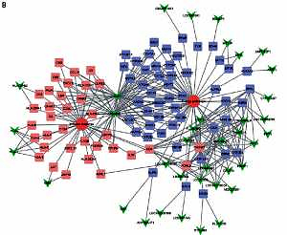

Comprehensive analysis of key lncRNAs in HCV-positive hepatocellular carcinoma
DOI: 10.5114/aoms.2020.100675
Arch Med Sci 2021;17(1):142-151
Notes:
Introduction
Hepatocellular carcinoma (HCC) is one of the most common cancers worldwide. Despite the therapeutic advances in HCC in the past few decades, the mortality rate of HCC is still high. Hepatitis C (HCV) infection is one of the major etiological risk factors of HCCs. However, the underlying mechanisms of HCV-induced hepatocarcinogenesis remain largely unclear.
Material and methods
Our study represented the comprehensive analysis of differentially expressed lncRNAs in HCV-positive HCC for the first time by analyzing the public dataset GSE17856. Co-expression network and gene ontology (GO) analysis revealed the functions of those differentially expressed lncRNAs.
Results
We identified 256 upregulated lncRNAs and 198 downregulated lncRNAs in HCV- positive HCC compared to the normal liver tissues. Co-expression network and GO analysis showed that these lncRNAs were involved in regulating metabolism, energy pathways, proliferation and the immune response. Seven lncRNAs (LOC341056, CCT6P1, PTTG3P, LOC643387, LOC100133920, C3P1 and C22orf45) were identified as key lncRNAs and co-expressed with more than 100 differentially expressed genes (DEGs) in HCV-related HCC. Kaplan-Meier analysis showed that higher expression levels of LOC643387, PTTG3P, LOC341056, CCT6P1 and lower expression levels of C3P1 and C22orf45 were associated with shorter survival time in the TCGA dataset.
Conclusions
We believe that this study can provide novel potential therapeutic and prognostic biomarkers for HCV-positive HCC.

