Slide 1
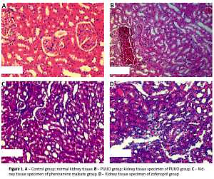

Evaluation of pheniramine maleate and zofenopril in reducing renal damage induced by unilateral ureter obstruction.
An experimental study
DOI: 10.5114/aoms.2019.88320
Arch Med Sci 2021;17(3):812-817
Notes:
Introduction
Obstruction of the ureter may occur due to congenital, iatrogenic or other reasons. This can cause hydronephrosis in the early stage and can lead to cellular inflammation, necrosis and atrophy in the kidney tissue. The aim of this paper is to evaluate the protective effect of pheniramine maleate (PM) and zofenopril on renal damage caused by hydronephrosis due to unilateral partial ureter obstruction.
Material and methods
Twenty-four female Sprague Dawley rats were divided into 4 groups. Group 1: sham group, group 2: partial unilateral ureteral obstruction (PUUO) group, group 3: PUUO + PM group, group 4: PUUO + zofenopril group. Paraoxonase (PON), total antioxidant status (TAS) and total oxidant status (TOS) of tissue and blood samples were measured and calculated. Tissue samples were evaluated histopathologically.
Results
An increase in tissue TAS and a decrease in tissue TOS and OSI levels were detected in groups 3 and 4 compared to group 2 (both: p < 0.01). Tissue PON levels showed an increase in groups 3 and 4 compared to groups 1
and 2 (both: p < 0.01). Histopathological evaluation showed a decrease in interstitial inflammation and congestion in groups 3 and 4 compared to the control group (p < 0.001). The decrease was observed to be more significant in group 4 compared to group 3 (p < 0.01).
Conclusion
In our experimental study, we observed that PM and zofenopril reduce the oxidation and tissue damage caused by unilateral partial obstruc­tion.

