Slide 1
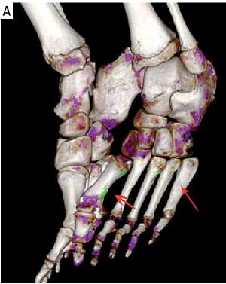

Urate crystal deposition in hyperuricemic children: a dual energy computed tomography study
DOI: 10.5114/aoms/89835
Arch Med Sci 2021;17(1):100-105
Notes:
Introduction
The incidence of hyperuricemia (HUA) at younger ages is increasing along the coastal regions of China. This study aimed to compare the frequency of dual energy CT (DECT) urate crystal deposition between symptomatic hyperuricemic children and asymptomatic hyperuricemic children.
Material and methods
Fifty-six hyperuricemic children were divided into a Joint Group (n = 33) and an Asymptomatic Group (n = 23) according to whether they had a history of arthritis symptoms, which includes rapid onset monoarthritis with intense pain and swelling. We analyzed DECT scans of their feet from the Joint Group and the Asymptomatic Group and compared their clinical features.
Results
DECT urate deposits were observed in 28/33 (84.8%) children with symptomatic HUA and 14/23 (60.9%) with asymptomatic HUA. We found 60 areas of urate deposition in the Joint Group; DECT urate crystal deposition was most frequently observed in the first metatarsophalangeal (MTP) joint (30.0%), ankle joint (15.0%), and calcaneus (13.3%). 39 urate deposits were found in the Asymptomatic Group; DECT urate crystal deposition was most frequently observed in the calcaneus (25.6%), the first MTP joint (17.9%), and the first phalanx (15.4%).
Conclusions
Urate deposition can occur in children with HUA, and these deposits occur more frequently in hyperuricemic children with a history of arthritis symptoms. Also, the urate deposition in the first MTP joint and calcaneus was more prevalent than in other joints. It is important to give more attention to hyperuricemic children.

