Slide 1
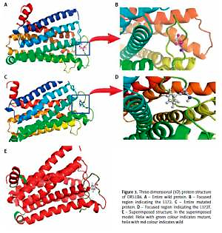

Haemoglobin switching modulator SNPs rs5006884
is associated with increased HbA2
in β-thalassaemia
carriers
DOI: 10.5114/aoms.2019.86705
Arch Med Sci 2021;17(4):1064-1074
Notes:
Introduction
Haemoglobin A<sub>2</sub> (HbA<sub>2</sub>), the tetramer of α- and δ-globin chains, is used as a diagnostic biomarker for β-thalassaemia carriers. The HbA<sub>2</sub> levels are regulated by the presence of HPFH, δ-thalassaemia, HbA<sub>1/2</sub> gene triplication, and variants of KLF1, β-globin gene, and HbF regulating QTLs. Saudi Arabia has a high incidence of borderline HbA<sub>2</sub> levels, thereby making it difficult to classify the haemoglobinopathies. This study aims to investigate the association of known HbF enhancer QTL gene SNPs with HbA<sub>2</sub> levels
Material and methods
14 Specific SNPs in BCL11A, HMIP, OR51B6, HBBP1, and HBG2 loci were genotyped in 164 Saudi β-thalassaemia carriers by TaqMan assay to validate their role as regulators of HbA<sub>2</sub> levels. HbA<sub>2</sub> levels were determined using the Variant II β-Thalassemia Short Program Recorder kit. The non-random association of these SNPs was tested using HaploView software. Protein inter-action was assessed using 3D structure modelling for OR51B6 (rs5006884), comparative energy minimisation, and root-mean-square deviation (RMSD) prediction.
Results
Elevated HbA<sub>2</sub> levels were associated with SNPs in HBBP1, OR51B6, and TCT haplotype from HBG2 promoter region. The bioinformatics modelling and prediction revealed that the exonic rs5006884 had RMSD value deviations and significantly varied binding energy minimisation. α-globin variations were found in 57.92% of individuals but were not associated with elevated HbA<sub>2</sub>.
Conclusions
The haemoglobin switching modulators rs2071348, rs7482144, and rs5006884 are involved in regulation of HbA<sub>2</sub> level with rs5006884 influencing the tetramer formation. Screening for haemoglobinopathies should take these SNPs into consideration, specif-ically in borderline HbA<sub>2</sub> cases. Assiduous analysis of rs5006884 as HbA<sub>2</sub> modulator for amelioration of disease severity is recommended.

