Slide 1
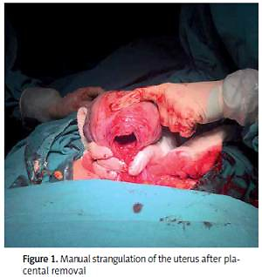

Manual strangulation of the uterine isthmus after placental removal to reduce blood loss during cesarean section
DOI: 10.5114/aoms.2019.90334
Arch Med Sci 2021;17(4):915-919
Notes:
Introduction
This study aimed to evaluate the effect of manual strangulation of the uterine isthmus on the amount of blood loss during cesarean section.
Material and methods
This is a prospective randomized controlled trial. A total of 118 participants were enrolled in the study. Manual strangulation of the uterine isthmus just after placental removal was performed during cesarean section in group I (n = 57; the strangulation group). Strangulation was not performed in group II (n = 61; the control group). Preoperative and postoperative venous blood hemoglobin, capillary hemoglobin, and absorbed blood levels during the operation were compared between the two groups.
Results
The median age of the patients was 28.5 (19–41). The median body
mass index of the patients in the study was 27 (21–42). There were no
significant differences in the demographic characteristics of the patients
between the groups. The median difference between the preoperative and
postoperative 4–6 h capillary hemoglobin values was significantly lower in
the strangulation group (2.0 (0–9)) than in the control group (3.0 (0–8)).
The amount of absorbed blood during the operation was also significantly
lower in the strangulation group (164.5 ml (69–1310)) than in the control
group (230 ml (35–3223)).
Conclusions
Manual uterine strangulation of the uterine isthmus immediately after the removal of the placenta may induce a 30% decrease in blood loss during cesarean section.

