Slide 1
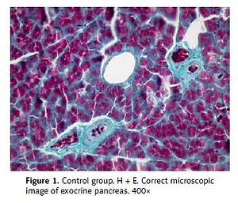

The influence of erythropoietin on apoptosis
and fibrosis in the early phase of chronic pancreatitis
in rats
DOI: 10.5114/aoms.2020.99800
Arch Med Sci 2021;17(4):1100-1108
Notes:
Introduction
Chronic pancreatitis (CP) is a continuing, inflammatory process of the pancreas, characterised by irreversible morphological changes. The identification of pancreatic stellate cells resulted in the development of research on the pathogenesis of CP. Erythropoietin (Epo) regulates the interaction between apoptosis and inflammation of the brain, kidney, and heart muscle. Erythropoietin receptors were also found in the pancreas, in particular on the islet cells. Our objective was to evaluate the influence of Epo on fibrosis and apoptosis in experimental CP.
Material and methods
The experiments were performed on 48 male Wistar rats (250–350 g). The animals were divided into six equal groups (I – control, II – chronic cerulein – induced pancreatitis, III – 1 ml of Epo sc, IV – 0.5 ml of Epo sc, V – CP treated with 1 ml Epo, VI – CP treated with 0.5 ml Epo). The blood for gelatinases and pancreata for the morphological examinations and immunohistochemistry were collected.
Results
A slight reduction of interstitial oedema and less severe fibrosis were noticed in the groups treated with Epo. Reduced expression of caspase-3 and -actin, and a lack of Bcl-2 expression were observed in areas with inflammation. There was no expression of caspase-9 observed in all groups. There were no statistically significant differences between the groups in the activity of gelatinases.
Conclusions
Erythropoietin seems to have the effect of reducing fibrosis and apoptosis in an experimental model of CP.

