Slide 1
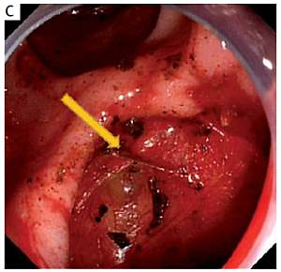

The role of periampullary diverticulum on the incidence
of pancreaticobiliary diseases and the outcome
of endoscopic retrograde cholangiopancreatography
DOI: 10.5114/aoms.2020.94591
Arch Med Sci 2021;17(4):905-914
Notes:
Introduction
Periampullary diverticulum (PAD), although commonly discover¬ed in patients undergoing endoscopic retrograde cholangiopancreatograp¬hy (ERCP), remains controversial regarding its role in pancreaticobiliary diseases and the failure rate of cannulation. The aim of this study was to evaluate the association of PAD with pancreaticobiliary diseases and its impact on the outcome of ERCP.
Material and methods
A retrospective analysis was carried out on 1455 patients who underwent an ERCP. Patients were divided into a PAD group and a control group without PAD, and propensity score matching was performed to adjust for clinical differences. The comparison was focused on pancreaticobiliary diseases, technical success, and complications of ERCP.
Results
The occurrence of PAD is associated significantly with increasing age (p < 0.001). Incidences of acute pancreatitis (AP), suppurative cholangitis, and pancreatic head cancer were significantly higher in the PAD group (p < 0.05). After propensity score matching, the PAD group exhibited a higher rate of post-ERCP complications including haemorrhage, post-ERCP pancreatitis (PEP), and hyperamylasaemia (p < 0.05). However, the prevalence of perforation and the success rate of ERCP did not differ between groups (p > 0.05).
Conclusions
Periampullary diverticulum develops with aging and seems to be associated with an increase in pancreaticobiliary diseases and post-ERCP complications except for perforation. Additionally, the presence of PAD does not affect the technical success of ERCP.

