Slide 1
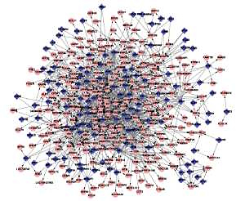

Analysis of master transcription factors related to Parkinson’s disease through the gene transcription regulatory network
DOI: 10.5114/aoms.2019.89460
Arch Med Sci 2021;17(5):1184-1190
Notes:
Introduction
This study investigated the relationships between differentially co-expressed gene pairs or links (DCLs) and transcription factors (TFs) in the gene transcription regulatory network (GTRN) to clarify the molecular mechanisms underlying the pathogenesis of Parkinson’s disease (PD).
Material and methods
Microarray dataset GSE7621 from Gene Expression Omnibus (GEO) was used to identify differentially expressed genes (DEGs) and perform Gene Ontology (GO) enrichment analysis. Differentially co-expressed genes (DCGs) and DCLs were identified by the DCGL package in R soft-ware. DCLs that were potentially related to the regulation mechanisms, and corresponding TFs, were identified using the DR sort function in the DCGL V2.0 package. The GTRN was constructed with these DCLs-TFs, and visualized with Cytoscape software.
Results
A total of 131 DEGs, including 77 up-regulated DEGs and 54 down-regulated DEGs, were identified, which were mainly enriched for plasma membrane, cell activities, and metabolism. We found that ICAM1-LTBP and CTHRC1-UTP3 might alter gene regulation relationships in PD. The GTRN was constructed with DCLs-TFs, including 348 nodes (118 TFs and 230 DCGs) and 1045 DCLs. These TFs (AHR, SP1, PAX5, etc.) could regulate many target genes (e.g. ICAM1 and LTBP) in the GTRN of PD.
Conclusions
ICAM1 and LTBP may play a role in PD symptom development and pathology, and might be regulated by important TFs (AHR, SP1, PAX5, etc.) identified in the GTRN of PD. These findings may help elucidate the molecular mechanisms underlying PD and find a novel drug target for this disease.

