Slide 1
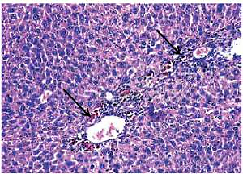

Effects of free and nanoparticulate curcumin on chemically induced liver carcinoma in an animal model
DOI: 10.5114/aoms.2020.93739
Arch Med Sci 2021;17(1):218-227
Notes:
Introduction
Curcumin therapeutic applications are constrained by its prominent metabolic instability as well as inadequate absorption and bioavailability. The current study was designed to enhance the curcumin bioavailability by exploiting nanoparticles.
Material and methods
Eleven groups of mice were divided into: normal and nanoparticle control groups, a hepatocellular carcinoma (HCC) group induced by diethylnitrosamine (DEN), 2 groups treated with DEN plus a high dose/low dose of free curcumin, 2 groups treated with a high dose/low dose of free curcumin, 2 groups treated with DEN plus a high dose/low dose of nanoparticulate curcumin, and 2 groups treated with a high dose/low dose of nanoparticulate curcumin.
Results
DEN administration significantly increased liver enzymes, vascular endothelial growth factor, tumor necrosis factor-α, α-fetoprotein, malondialdehyde, and nucelar factor-κB. Also, it decreased serum albumin and tissue antioxidant activities and caused severe histological changes in hepatic tissue. Oral treatment of DEN-injected mice with either a high dose of free curcumin or the tested doses of nanoparticulate curcumin resulted in a significant improvement of all the tested parameters.
Conclusions
Although the two tested doses of nanoparticulate curcumin were much lower than free curcumin, both doses were effective in preventing HCC development while the low dose of free curcumin was hardly effective. Hence, we conclude that nanoparticles enhance the bioavailability of curcumin.

