Slide 1
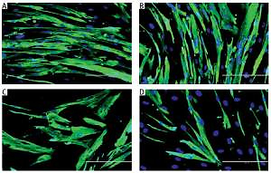

Modulation of Ki67 and myogenic regulatory factor
expression by tocotrienol-rich fraction ameliorates
myogenic program of senescent human myoblasts
DOI: 10.5114/aoms.2019.85449
Arch Med Sci 2021;17(3):752-763
Notes:
Introduction
Replicative senescence results in dysregulation of cell proliferation and differentiation, which plays a role in the regenerative defects observed during age-related muscle atrophy. Vitamin E is a well-known antioxidant, which potentially ameliorates a wide range of age-related manifestations. The aim of this study was to determine the effects of tocotrienol-rich fraction (TRF) in modulating the expression of proliferation- and differentiation-associated proteins in senescent human myoblasts during the differentiation phase.
Material and methods
Human skeletal muscle myoblasts were cultured until senescence. Young and senescent cells were treated with TRF for 24 h before and after differentiation induction, followed by evaluation of cellular morphology and efficiency of differentiation. Expression of cell proliferation marker Ki67 protein and myogenic regulatory factors MyoD and myogenin were determined.
Results
Our findings showed that treatment with TRF significantly improved the morphology of senescent myoblasts. Promotion of differentiation was observed in young and senescent myoblasts with TRF treatment as shown by the increased fusion index and larger size of myotubes. Increased Ki67 and myogenin expression with TRF treatment was also observed in senescent myoblasts, suggesting amelioration of the myogenic program by TRF during replicative senescence.
Conclusions
TRF modulates the expression of regulatory factors related to proliferation and differentiation in senescent human myoblasts and could be beneficial for ameliorating the regenerative defects during aging.

